Slide 1
Bootstrapping a Modelica Compiler
Martin Sjölund, Peter Fritzson, Adrian Pop
Linköping University
2011-03-22
8th International Modelica Conference
Dresden, Germany

Slide 2
Vision
Build a modular and extensible Modelica compiler
Compiler functionality resides in Modelica libraries
Build toolchains with a Modelica editor using the components in the compiler libraries

Slide 3
Bootstrapping
How to compile a compiler for language A, written in a subset of the same language
  (Cross-)Compile using an existing A-compiler
  Use an existing A-interpreter
  Write an A-compiler in language B
Circular dependency
  Important not to break the compiler
  Cannot use language features until you implement them yourself

Slide 4
MetaModelica
To realize our vision, we need our compiler to understand the language that the libraries are written in
  The libraries should be written in some dialect of Modelica
MetaModelica 1.0
  Extended subset of Modelica
  OpenModelica is written in this language and compiled using MMC

Slide 5
Why Bootstrapping?
MMC, the old MetaModelica Compiler
  Written in RML+SML
  Hard to maintain
  Hard to extend
OMC, the Modelica+MetaModelica Compiler
  We get language features for free
  Easy to extend
  Easy to port MetaModelica extensions to Modelica
  Debugging, Profiling, Testing

Slide 6
MetaModelica 2005-2011
MetaModelica 1.0 is created as an extended Modelica subset
Implementation of a MetaModelica compiler using a translation to RML
Automatic translation of OpenModelica source code (written in RML) to MetaModelica
Implemention of MetaModelica extensions in OpenModelica
Code generation, runtime, and garbage collection
MetaModelica 2.0 is the result of implementing MetaModelica 1.0 in OpenModelica

Slide 7
MetaModelica 2.0+ Extensions
Features we cannot use due to RML/MMC being hard to extend
  if-statement, if-expressions
  Builtin support for list mapping, filtering, folding
  Shorter syntax for polymorphic functions
  More powerful patterns when pattern-matching, including guard-expressions
  A richer package structure (RML/MMC is flat)
  Inheritance, modifications, redeclare
  Default bindings of local variables

Slide 8
Structure of a Modelica Compiler
Symbolic Math
Parser
Translator
Analyzer
Optimizer
CodeGen
Interpreter

Slide 9
What is missing in Modelica?
Implementing a Parser or Symbolic Math Library in Modelica
  ”Impossible”
  Modelica only has flat data structures
  Expressions are recursive data
  structures (trees)
1 | 2 | 3 | ... | n

Slide 10
Introducing the Union Type
1.5 + ((... + ...) - 2.5)
uniontype Expression
record REAL "A real constant"
Real r;
end REAL;
record ADD "lhs + rhs"
Expression lhs, rhs;
end ADD;
record SUB "lhs - rhs"
Expression lhs, rhs;
end SUB;
end Expression;
ADD
REAL
1.5
SUB
ADD
REAL
2.5

Slide 11
Lists
No parametric union types
Defining a new uniontype for each kind of list is not desirable
The list is a common data type
So we introduce a List type
array(1,2,...,n)
CALL
array
INT
1
INT
2
...
INT
n

Slide 12
Options, Tuples
Option: a new type similar to null in Java
  NONE()
  SOME(value)
Tuples: Anonymous records
  (1,1.5,"abc",true)

Slide 13
Accessing Data Structures
Accessor functions
  j := if not listEmpty(lst) then 2*listGet(lst, 1) else 3;
Introducing pattern-matching in Modelica
j := match lst
local Integer i;
case (i :: _) then 2*i;
else 3;
end match;

Slide 14
Polymorphism
Reusable functions
  Works for any type
  Boxed data types
No need to extend functions and redeclare types
function listFirst<A>
input List<A> lst;
output A first;
algorithm
first :: _ := lst;
end listFirst;

Slide 15
The Bootstrapped Compiler
First version, Nov-Dec 2010
  10-100x slower than MMC
  Slow compilation speed (hours)
  Most tests failed due to lack of memory
Jan-Feb 2011
  Speed similar to MMC
  Faster compilation than MMC
  Most tests succeed despite lack of garbage collection

Slide 16
Garbage collection (I)
First version, March 2011
  GC is currently slower than MMC GC (~50 times)
Details
  Based on mark-and-sweep garbage collection
  Live data is marked starting from roots (variables on the stack and local variables)
  Everything that is not marked becomes free memory in the sweep phases (which also removes the marking on live data)

Slide 17
Garbage collection (II)

Slide 18
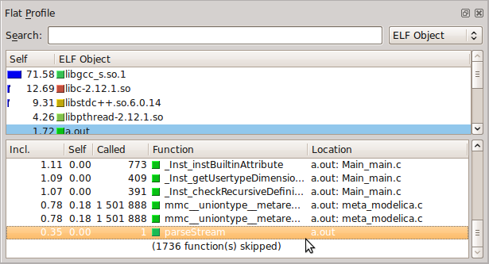
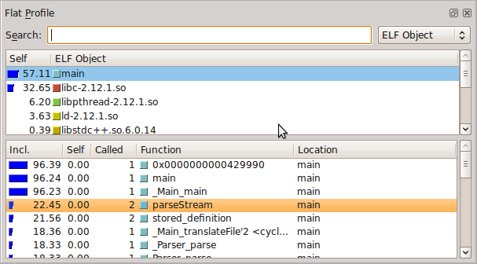
Optimizations
PEXPipe.mo before and after optimizations
2010-11-24
2011-02-05

Slide 19
Compiler Performance
Task | MMC | OMC | Factor
EngineV6Analytic, checkModel, time | 55.908s | 55.553s | 0.99x
EngineV6Analytic, checkModel, memory | 400MB | 7GB | 17.5x
All 1379 tests, single thread, time | 24m8s | 20m55s | -
All 1379 tests, number of failed tests | 13 | 30 | -
Excluding failing tests, 1349 total | 17m25s | 18m | 1.03x

Slide 20
Outlook
Spring 2011
  Optimizations in the garbage collector
  Testing the implementation on all platforms (Linux, OMDEV, OSX and Visual Studio)
Fall 2011
  Replacing MMC with OMC
  Rewriting compiler sources using new language extensions
  Add more optimizations

Slide 21
Thanks for listening!
Visit us at http://openmodelica.org

Slide 22
Compilation of OpenModelica
Task | MMC | OMC | Factor
Translate sources to C | 98.8s | 49.7s | 0.50x
Compile C, gcc –O3 | 233.3s | 152.0s | 0.65x
Executable size | 18.7MB | 5.43MB | 0.29x
Compile C, gcc –Os | 218.9s | 102.8s | 0.47x
Executable size | 10.3MB | 5.10MB | 0.50x
Debug version, gcc –g –O3 | 1405s | 152.5s | 0.11x
Executable size | 125MB | 25MB | 0.20x

